Slide 1
RCFEs and COVID-19
The purpose of this presentation is to inform you as to how RCFE’s (Board & Care, Assisted Living & Memory Care) are currently handling New Admissions, Current Residents, and Readmissions during the COVID-19 pandemic. This presentation will also cover how you can work with the homes to have a safe, and timely discharge.

Slide 2
Admission/Intake Process
Intake Protocols:
Negative COVID test prior to admission (most require the test and results to be performed within 24-72 hours of the move in, with some requiring 2 Negative tests prior to admission). Nasal Swab test is preferred. If second test is a Serology test, that is usually acceptable.
Quarantine period ranging from 7-14 days within the Community
Virtual Tours – some allow for a perimeter tour viewing the property through the windows
Completed Physicians’s Report, with Physician signature
TB Test – via chest x-ray or skin scratch test – Results must be negative

Slide 3
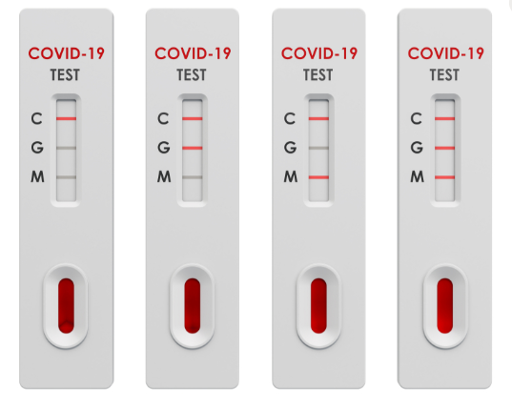
Serology Rapid Result COVID-19 Tests
Results within 15 minutes to 2 hours (timing depends on the test manufacturer)
Rapid result testing has an accuracy of 95% (according to the FDA)
Serology testing has a risk of a false positive result
Serology testing has a risk of a false negative result (can be due to levels of the virus being lower than the detection rate of the test)
Though not as accurate as the Nasal Swab test, a majority of homes will accept this test method for new admissions

Slide 4
Safety Inside the Communities
Quarantine period of 7-14 days – includes tray service, daily in room activities, and any physical care
Some larger capacity Communities have purchased their own rapid result tests and will retest the new resident after 7 days - With a negative result, Communities may release the resident from quarantine
All staff required to wear a mask at all times
All staff required to wear PPE (mask, gloves, sometimes gowns) when in contact with a resident
All residents required to wear a mask when outside of their rooms, or when in the company of any other residents or caregivers
Rolling cart/door-to-door happy hours
Small group dining at large tables – residents usually 6’ or more apart from one another
Socially distanced small group activities – chair exercises, bingo, music, etc.
In person visitation by family not allowed (exceptions made for residents nearing end-of-life)

Slide 5
Safety Inside the Communities – Memory Care
Due to the nature of Dementia, a quarantine period is unreasonable for most new admissions. There can be exceptions if the patient is high functioning, can communicate needs, and is able to follow direction easily, or if the patient is non-ambulatory and not at risk of wandering. Because of this, admissions into Memory Care can have more requirements prior to admission. COVID testing prior to admission will be required, sometimes with multiple tests.
Some of the things care facilities will be up against:
Hygiene – will need reminders to wash hands often. They will not be as careful to avoid touching surfaces, or their faces.
Social Distancing
Wearing masks
Behavioral issues – wandering, physical behaviors including aggression, behaviors involving incontinence, etc.
Activities
Meal times
Depression amongst residents – including weight loss due to failure to thrive
Facilities will want a thorough, and accurate evaluation of the patient’s needs, disposition, and behaviors in order to ensure that they can keep them and the other residents safe. There is a risk that a Community will become infected with COVID, so they need to be confident they can manage the residents safely.

Slide 6
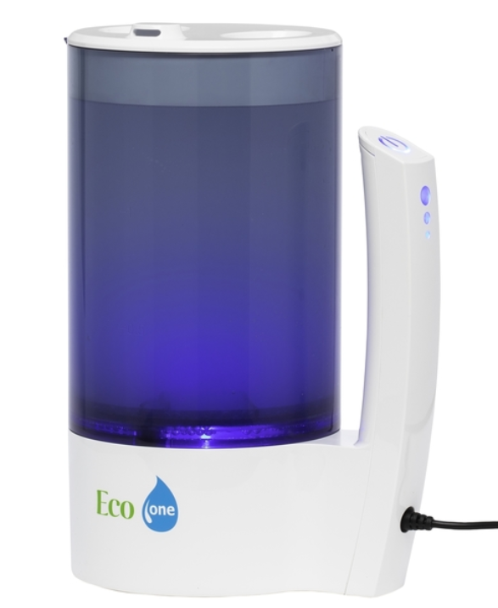
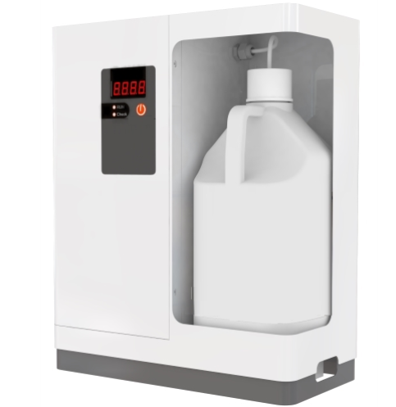
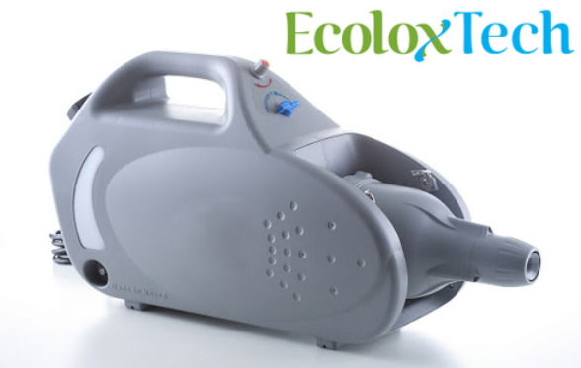
What is HOCL?
A few Communities are taking advantage of a technology called HOCL (Hypochlorous Acid). This is a cleaning process using water, uniodized salt, and electricity which then converts to Electrolyzed Water, or Hypochlorous Acid. It is 100x more effective than chlorine bleach at killing bacteria, bacterial spores, viruses and fungi. It has been proven to kill the SARS-CoV-2 (COVID-19). It is FDA, CDC, USDA and EPA approved.

Slide 7
How is HOCL used?
HOCL can be generated on site using a portable system, or a large scale system. It can be used as a disinfectant spray via a spray bottle, or can be used in a fog system (pictured below) to disinfect large spaces such as resident rooms and common areas. It is best used when sprayed onto a surface, and then allowed to dry. HOCL kills the virus within 5 minutes of exposure. Communities are also using a Fog System at their entrances in which a visitor would stand in the fog to be fully covered by the HOCL and disinfected prior to entrance into the Community.

Slide 8
Why is HOCL better?
HOCL is non-toxic, eco-friendly, highly effective and cost effective. It is generated on-site and on-demand. In a Memory Care setting, using HOCL is much safer for the residents than using a bleach based cleaner or any other toxic cleaner. In addition, you do not have to worry about an overwhelming chemical smell throughout the building. No special disposal required.

Slide 9
Family Involvement
How are Communities keeping families involved?
Video Chats
Regular emails with pictures and updates on their family member
Socially distant visitation in an outdoor setting allowed at some Communities

